Slide 1
BEFA UNIT-II

Slide 2
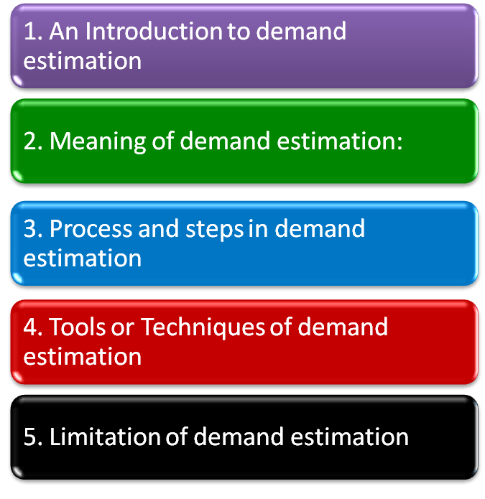
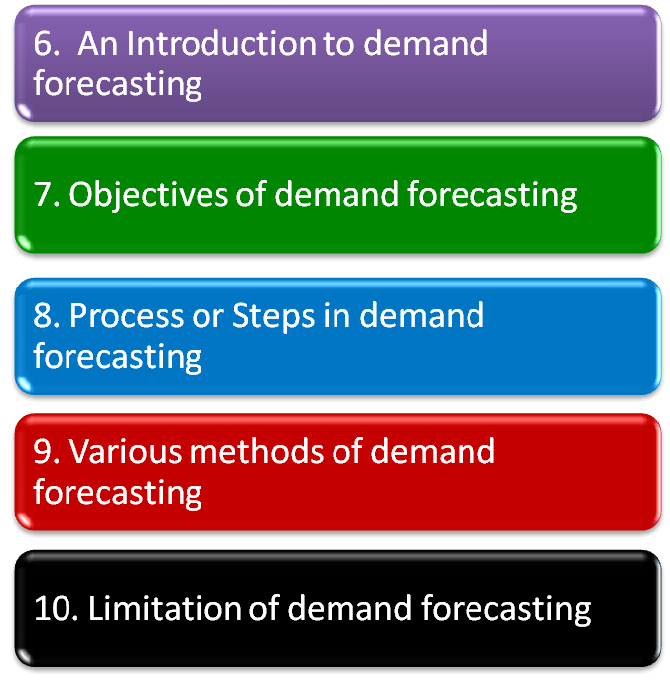
Agenda

Slide 3
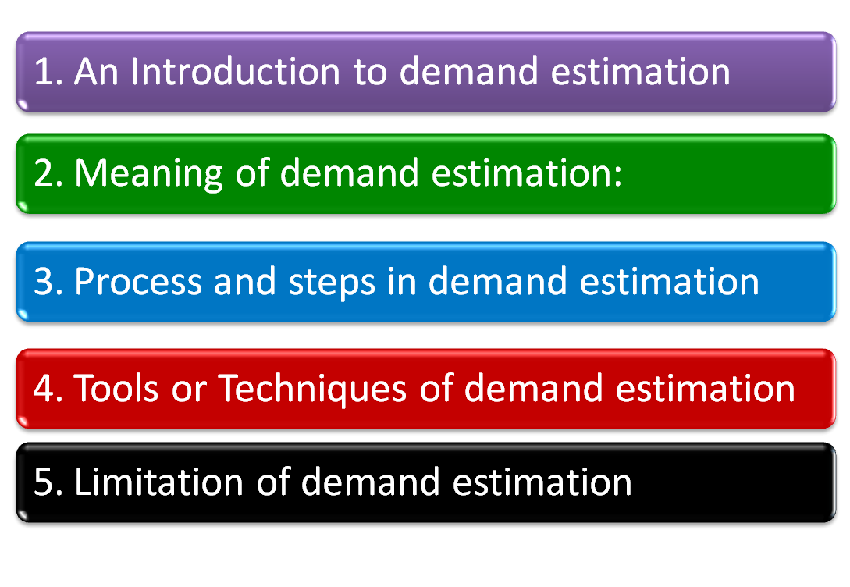
Demand estimation

Slide 4

Demand estimation
Uncertainty in business activity.
Risk involved in the business activity.
Success depends upon estimation and forecasting

Slide 5

Demand estimation
The estimation of quantitative nature of demand and the its determinants.
To understand the functional relationship between demands and its various determinants.
Demand function –> Q = f( Px, Y, Pr, Ad,etc)

Slide 6

Demand estimation
Identification of variable: Depended and independent variables
Development of model : Mathematical equation
Collection of data: Primary and Secondary sources of data
Estimation of parameter of the model
Development of estimates based on the model
Q = α₁ - α₂Px + α₃Y+ u

Slide 7

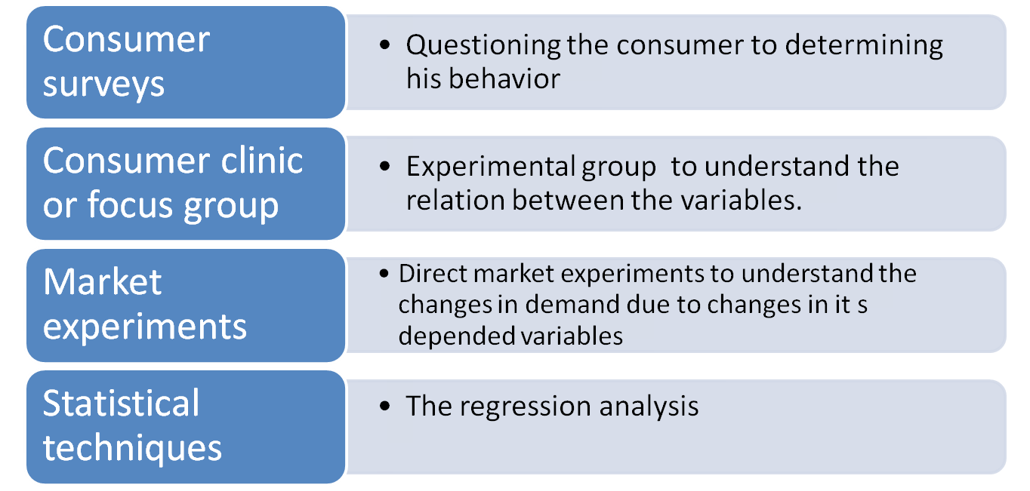
Demand estimation

Slide 8

Demand estimation
The model can not be exact
Quantitative and qualitative nature of consumer behaviour Indifferent consumer behavior

Slide 9
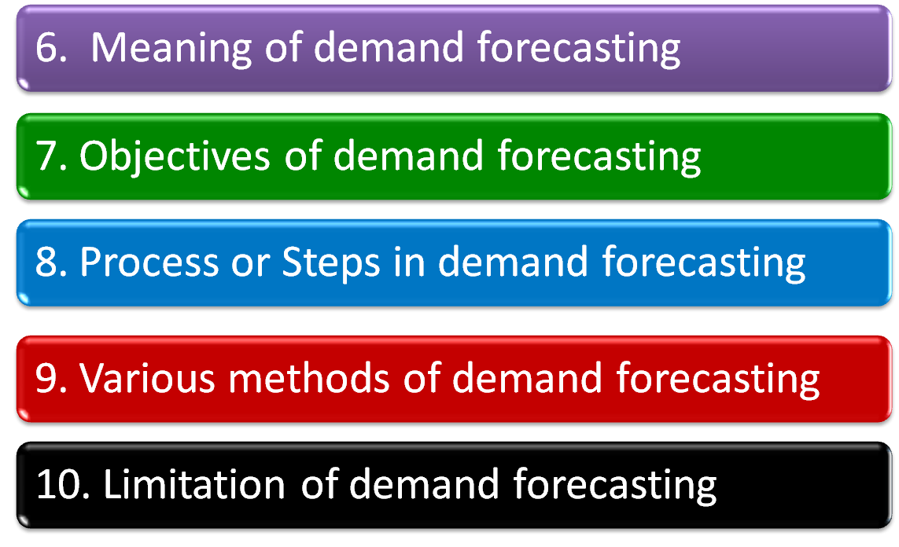
Demand forecasting

Slide 10

Demand forecasting
Estimating the anticipated future value of demand on the bases of past data.
What will be sale of gold in the next three year….
Long-run forecasting cover 5,10 or 20 years and short-run cover 3 months or 6 months.

Slide 11

Demand forecasting
To prepare suitable sales and production policy
To ensure the purchase of raw material and minimize the cost
Setting sale target and utilization of maximum recourses
To determine appropriate Advt. policy and promotion program.
Appropriate production scheduling to avoid the over production
It help to determined suitable price policy
To determined financial requirement

Slide 12

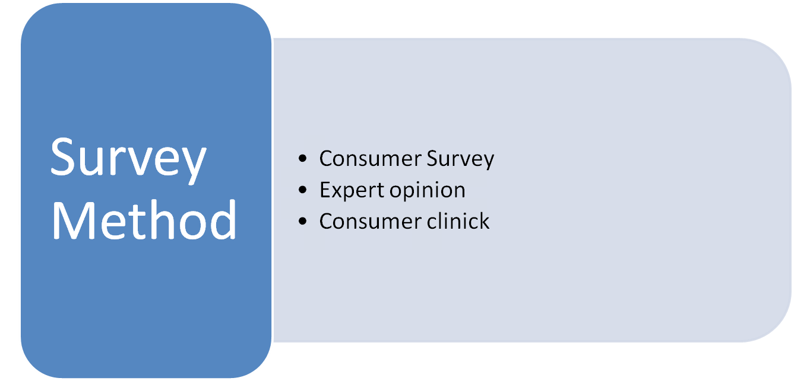
Demand forecasting

Slide 13
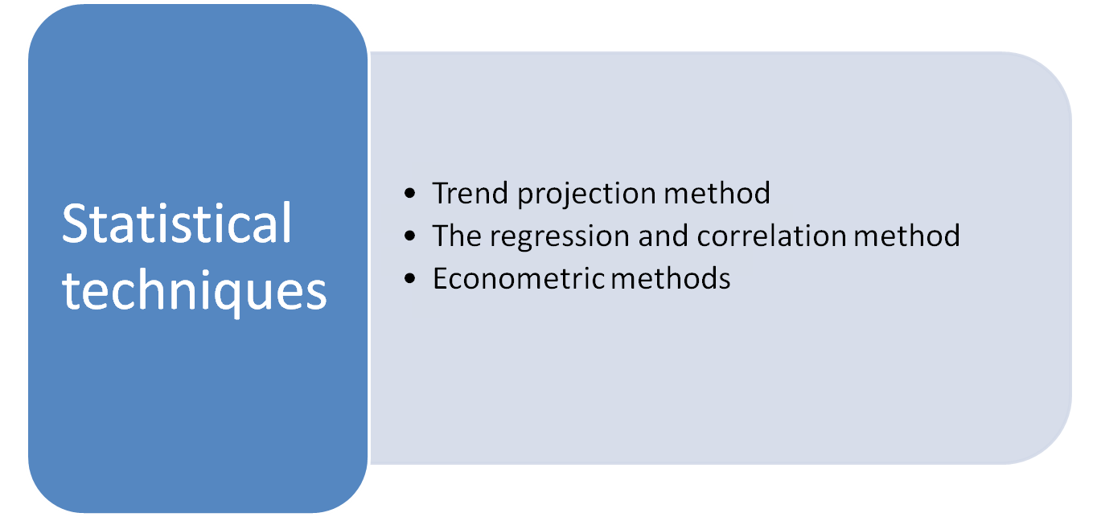
Demand forecasting

Slide 14

Demand estimation
If the forecaster is inefficient or inexperienced, the result may be worng
Demand depends to large no. of independent variables
Demand depends upon psychology of consumer
It is only a estimation, a certain amount of error is always there

